Slide 1
A Robust Push-to-Talk Service for Wireless Mesh Networks
Yair Amir, Raluca Musaloiu-Elefteri, Nilo Rivera
Distributed Systems and Networks Lab
Johns Hopkins University
IEEE SECON 2010

Slide 2
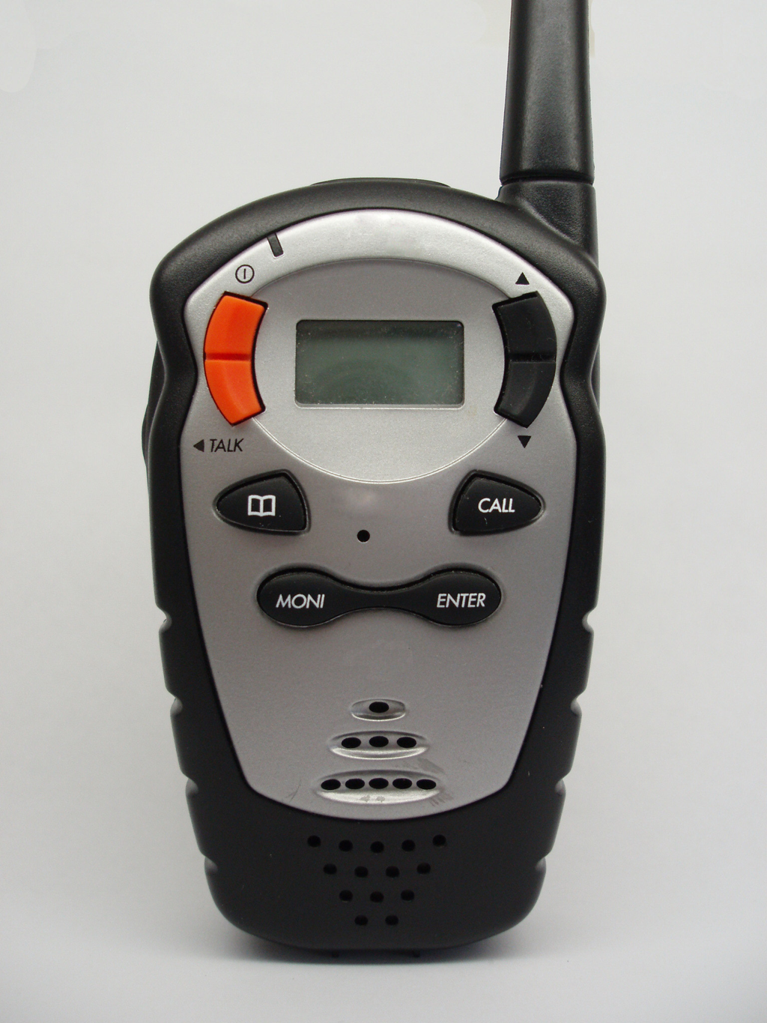
What is PTT?
Half-duplex communication system between multiple participants that share a single communication channel.
Only one user is granted Permission-to-Speak at a time (floor-control).
While one person speaks, the others listen.
Mostly used by public safety community as it enables coordinated communication and spectral efficiency.

Slide 3
Motivation
First responders cannot always rely on pre-existing infrastructure.
White House report on hurricane Katrina states that 1,477 cell towers were incapacitated, leaving millions unable to communicate.
Wireless Mesh Networks can be rapidly deployed for an instantaneous communication infrastructure.
We need a PTT service that works even when:
part of the infrastructure becomes unavailable (no centralized point of failure)
part of the infrastructure stops working (node crashes)
the system becomes partially disconnected (network partitions and merges)

Slide 4
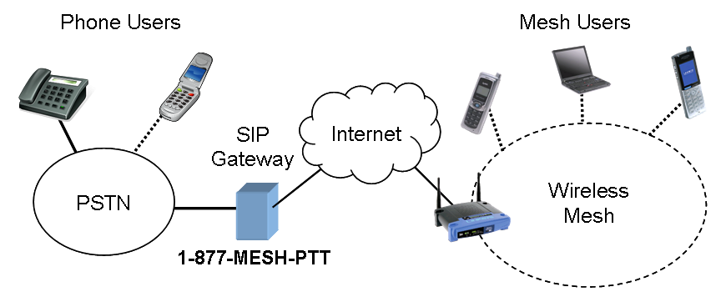
System Overview

Slide 5
Related Work and Background
Land Mobile Radio (Project 25 and TETRA)
D. Sharp, N. Cackov, N. Laskovic, Q. Shao, and L. Trajkovic, “Analysis of public safety traffic on trunked land mobile radio systems,” Selected Areas in Communications, IEEE Journal on, vol. 22, no. 7, pp. 1197– 1205, Sept. 2004.
Cell Phone Service (PoC – PTT over Cellular)
A. Balazs, “Push-to-talk performance over gprs,” in MSWiM ’04: Proceedings of the 7th ACM international symposium on Modeling, analysis and simulation of wireless and mobile systems. New York, NY, USA: ACM, 2004, pp. 182–187.
Decentralized VoIP Conferencing and PTT
J. Lennox and H. Schulzrinne, “A protocol for reliable decentralized conferencing,” in NOSSDAV ’03: Proceedings of the 13th international workshop on Network and operating systems support for digital audio and video. New York, NY, USA: ACM, 2003, pp. 72–81.
F. Maurer, “Push-2-talk decentralized,” 2004.
Notes:
PoC guidelines requires <1.6 seconds one-way-delay and < 4 seconds floor-switch-delay, but PTT requires <500ms. Also, PoC uses multi-unicast.

Slide 6
Outline
Architecture
Wireless Mesh Network (SMesh)
Client Seamless Access
Push-to-Talk Protocol
Client and Session Management
Floor Control
Protocol Robustness
Experimental Results

Slide 7
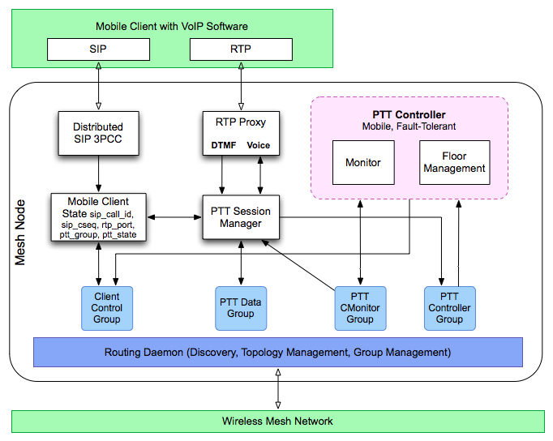
PTT Architecture

Slide 8
SMesh
www.smesh.org
[ACM Mobisys 2006], [IEEE WoWMoM 2007],
[IEEE WiMesh 2008], [ACM TOCS (accepted)].
7
Internet
1
8
5
6
4
2
3

Slide 9
Seamless user interaction
How to connect: | Mobile Client with VoIP: sip : ptt @ 192.168.1.10 (that’s a virtual SIP server) With a regular phone: dial : 1-877-MESH-PTT
How to join a group: | type # 12 #
How to request to speak: | type 5
How is notified when he has permission to speak: | receive a “beep-beep” audio signal

Slide 10
Outline
Architecture
Wireless Mesh Network (SMesh)
Client Seamless Access
Push-to-Talk Protocol
Client and Session Management
Floor Control
Protocol Robustness
Experimental Results

Slide 11
PTT Protocol – Controller
A PTT Session is coordinated by a PTT controller.
A PTT controller is initially instantiated on the mesh node with the lowest IP address that has clients for a PTT session.
Each PTT Session has a PTT Controller Group (an overlay multicast group) that a controller joins.
The controller migrates when another mesh node is better situated to handle a give PTT session (to the “center of gravity” according to the PTT session participants’ locations in the network).
Increase Performance (latency and # of transmissions)
Increase Availability (in the phase of network partitions)

Slide 12

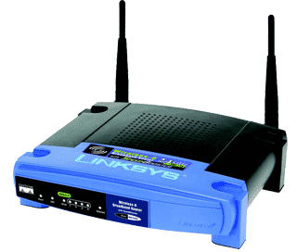
PTT Protocol – Management Groups
Client management
Control
Group
Session management
Controller
Group
Monitoring
Group
Data
Group

Slide 13
PTT Protocol - Monitors
Monitors
Monitors
Network
PING_CMON
Monitoring group
Controller
PTS_PING (client)
Controller group
Client AP
On timeout: Controller is lost
Action: If lowest IP on PTT group, assume controller role and start handling requests.
On timeout: Client AP is lost
Action: Handle the next client in the queue.
Voice
Monitors
Sending
client
On timeout: Client is Lost
Action: Send RELEASE

Slide 14
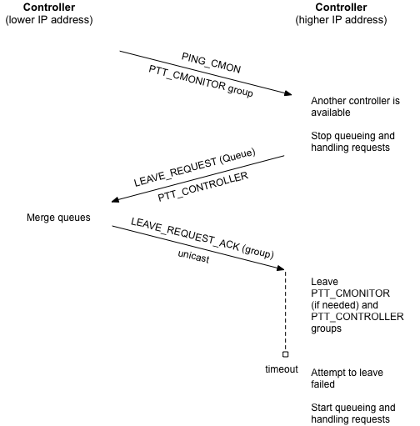
PTT Protocol – Partitions and Merges
A network partition looks like a controller failure in one side, and like a client AP and client failure in the other.
A network merge requires controllers detect each other and decide which one should take over a given PTT session.
Mechanism for detecting and recovering from situations when multiple controllers are present in the network.

Slide 15
Outline
Architecture
Wireless Mesh Network (SMesh)
Client Seamless Access
Push-to-Talk Protocol
Client and Session Management
Floor Control
Protocol Robustness
Experimental Results

Slide 16
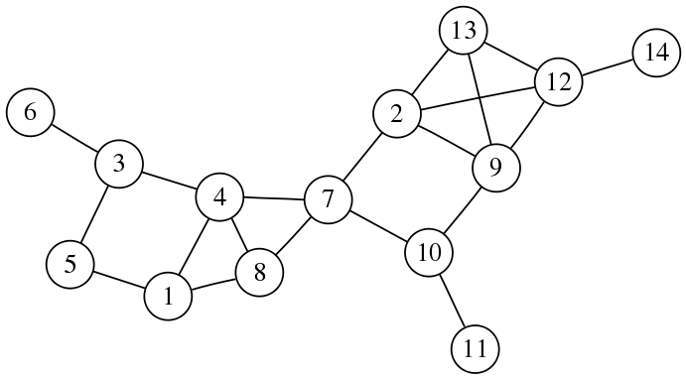
Testbed
14-Node Wireless Mesh Network
Rate | 18 Mbps
Transmission power | 50 mW
Retransmission limit | 7
VoIP stream | 64 Kbps
Speak duration | 20 sec
Client Emulator to support experiments with large number of clients

Slide 17
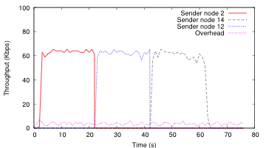
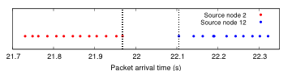
Normal Operation
Switch Latency
~140 ms
Avg Overhead
3.4 Kbps
Normal operation of the system, running in the 14-nodes testbed, with 4 clients on one PTT group.

Slide 18
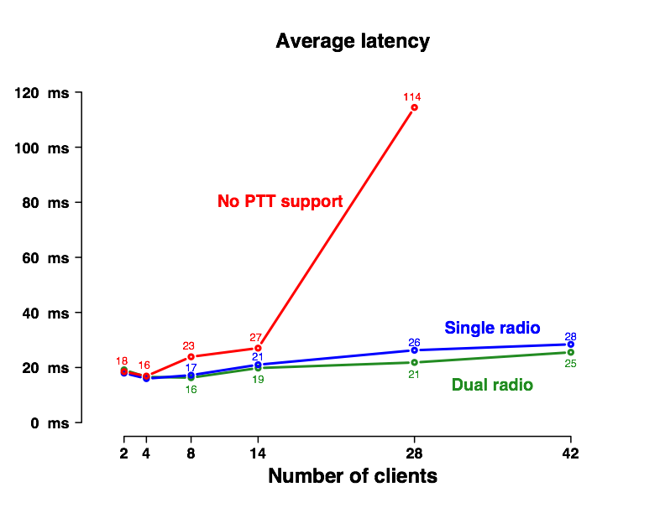
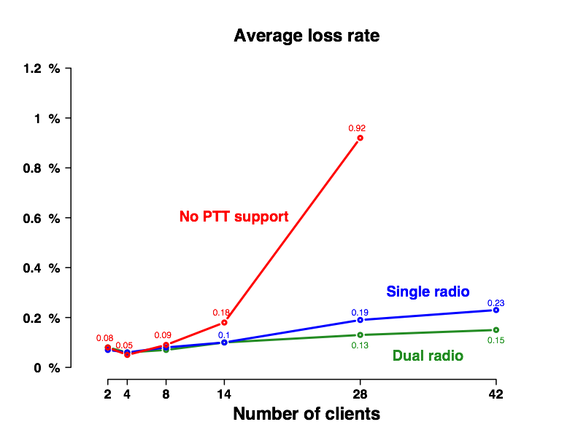
Scalability with Number of Clients
Average latency of the packets received by the mesh nodes, while increasing the number of clients on a single PTT group.
Average loss rate of the packets received by the mesh nodes, while increasing the number of clients on a single PTT group.

Slide 19
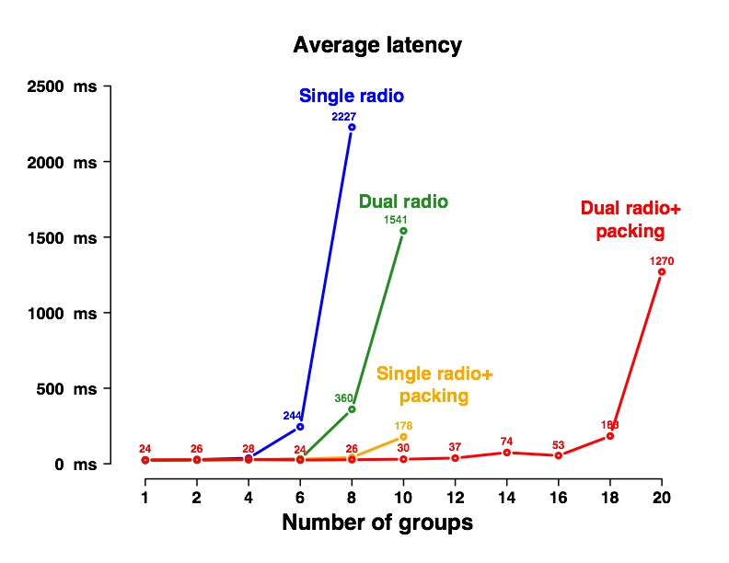
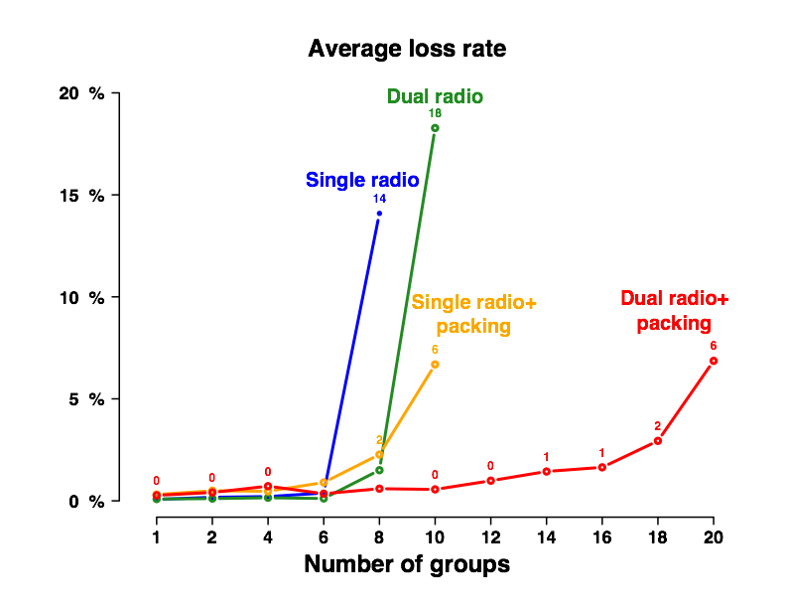
Scalability with Number of Groups
Average latency of the packets received by the mesh nodes, while increasing the number of PTT groups (4 clients per group).
Average loss rate of the packets received by the mesh nodes, while increasing the number of PTT groups (4 clients per group).

Slide 20
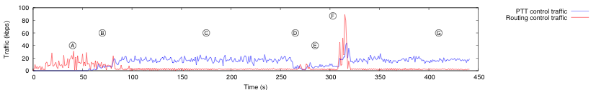
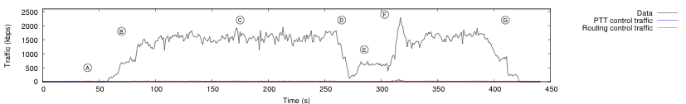
Large Scale Scenario
Large case scenario showing a network partition and merge. 40 clients join the 14-nodes system on 10 PTT groups (4 PTT users per group).
Black = Data Traffic Blue = PTT Control Traffic Red = Routing Control Traffic

Slide 21
Conclusion
Presented a robust PTT system that is highly available and works in the presence of node crashes and network partitions and merges.
System provides high availability while efficiently arbitrating the PTT sessions and efficiently disseminating voice traffic.
Seamless architecture for heterogeneous environments.
Experimental results demonstrate that PTT is a viable application for self-organizing mesh networks.

Slide 22
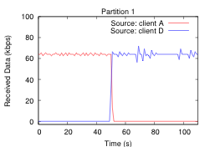
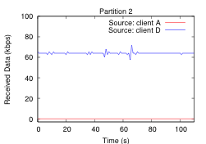
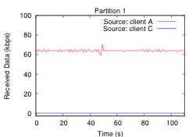
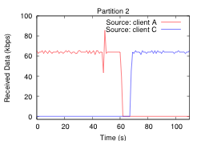
Network Partition and Merge

Slide 23
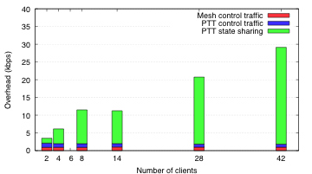
Overhead as number of clients grows on a single PTT channel

